Slide 1

How can I measure the surface of a balloon while someone is inflating it? What am I really measuring?
That is the question in a Period Census:
“Count” something that is changing with population dynamic
Iván Williams

Slide 2
Progressive count population (closed, with b=0.3 and d=0.1)
Survey scheme
50%
25%
25%
144
9
9
120
18
7.5
7.5
7
7
100
15
14
25
23
20
25
22.5
20
50
45
41
+30
+36
Total Count
50
80
116
Iván Williams

Slide 3
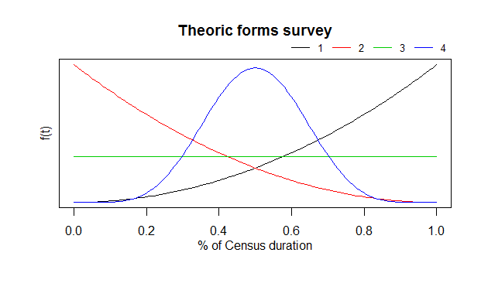
Questions:
The result is a count or an estimation?
-Census with variance?
-Estimation of Rates with census's count as exposure
Influence of survey scheme
Influence of duration extention: 3, 6, 9, 12 months cases in Latin America
In which point of time we must set the estimation?
Thanks!
Iván Williams

